Slide 1
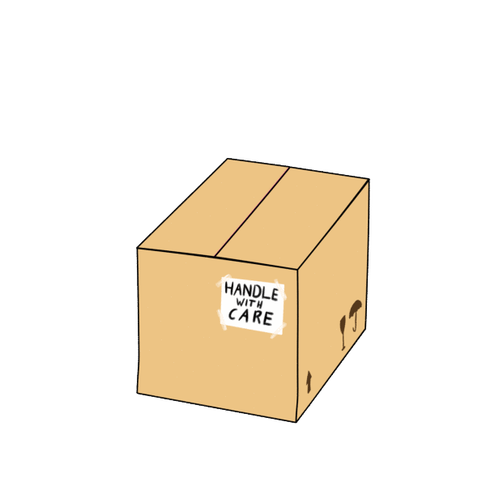
Take a guess.
What is it?

Slide 2
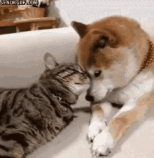
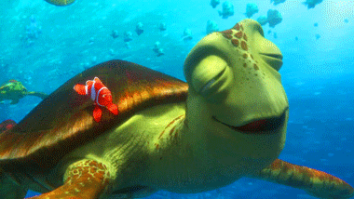
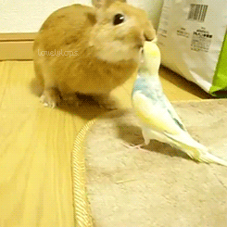
cute animals

Slide 3
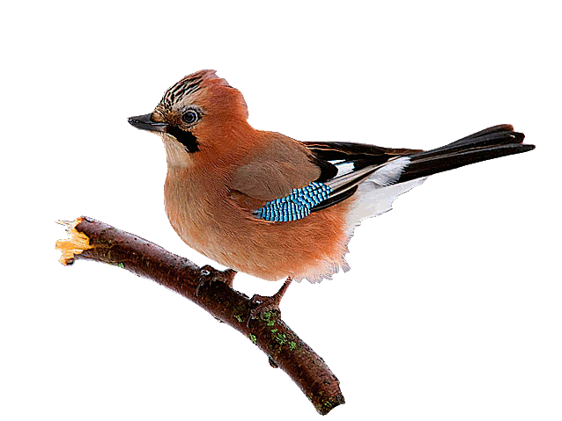
It’s a bird.

Slide 4
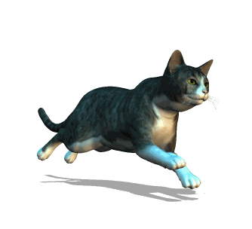
It’s a cat.

Slide 5
It’s a dog.

Slide 6
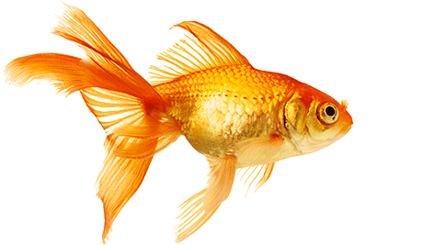
It’s a fish.

Slide 7
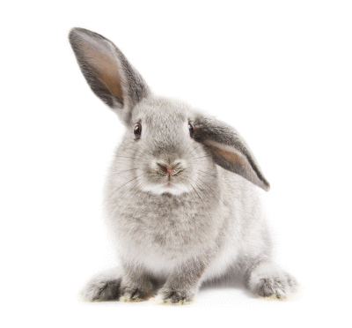
It’s a rabbit.

Slide 8
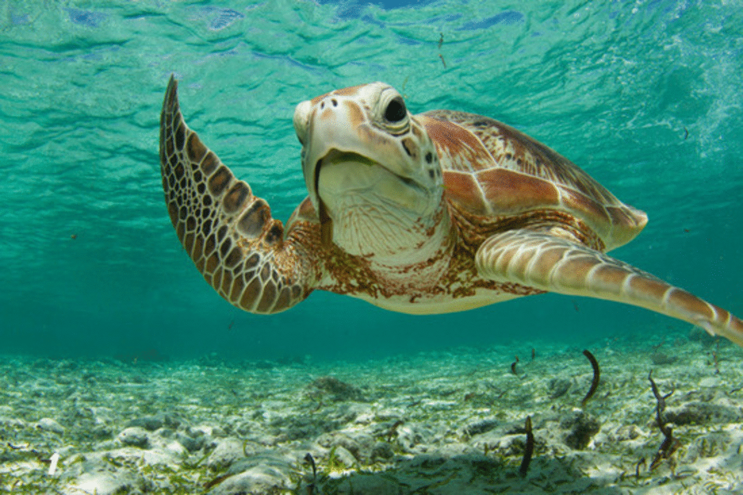
It’s a turtle.

Slide 9
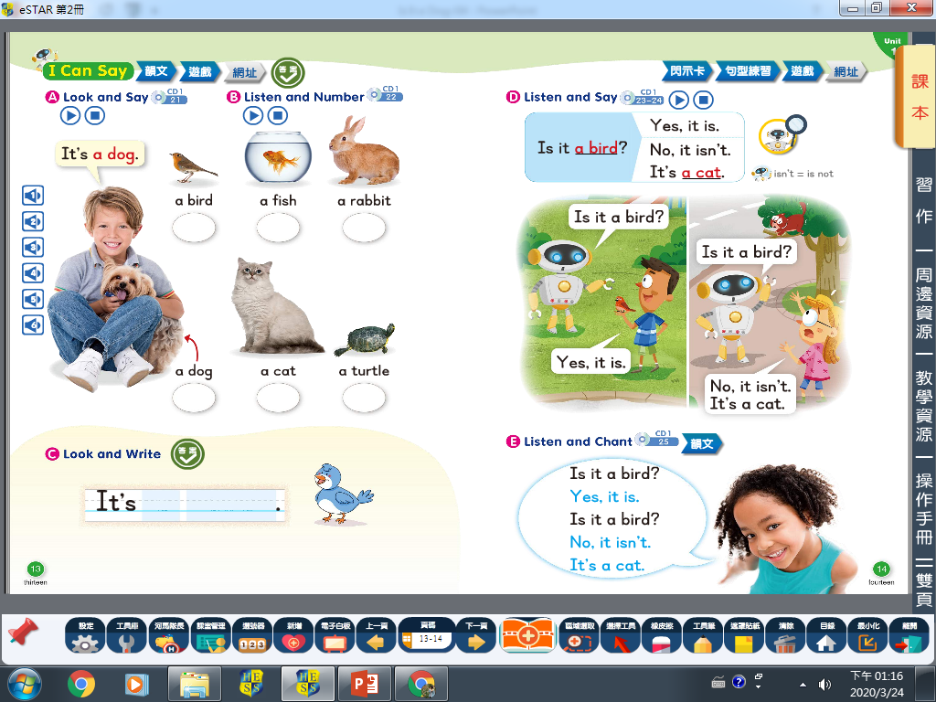

Slide 10
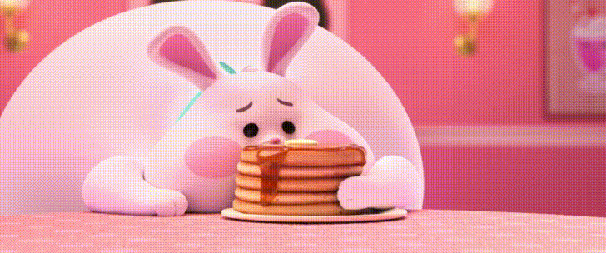
Is it a rabbit?

Slide 11
Yes, it is.
It’s a rabbit.
No, it isn’t.
It’s a turtle.

Slide 12
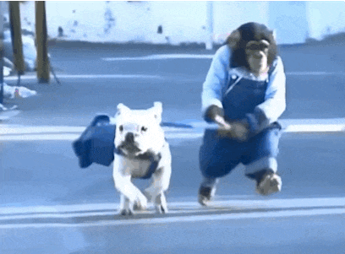
Is it a cat?

Slide 13
Yes, it is.
It’s a cat.
No, it isn’t.
It’s a dog.

Slide 14
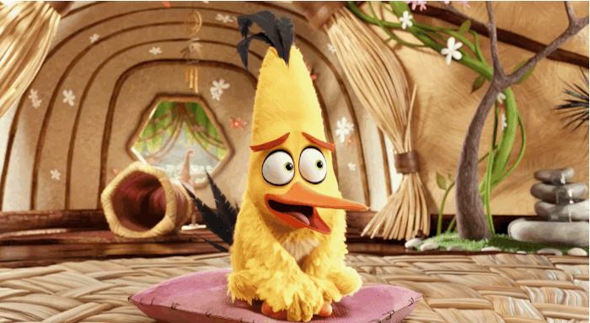
Is it a bird?

Slide 15
Yes, it is.
It’s a bird.
No, it isn’t.
It’s a fish.

Slide 16
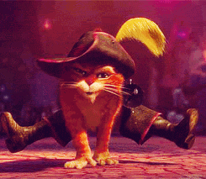
Is it a dog?

Slide 17
Yes, it is.
It’s a dog.
No, it isn’t.
It’s a cat.

Slide 18
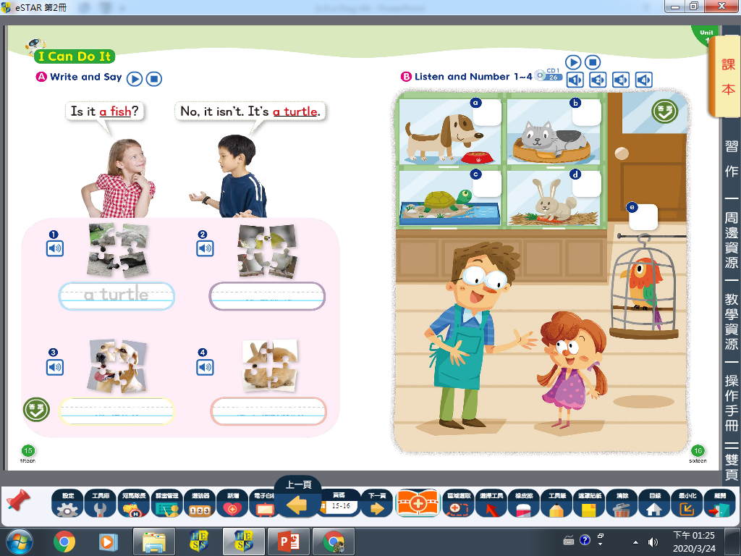

Slide 19
Come to tell me.

Slide 20
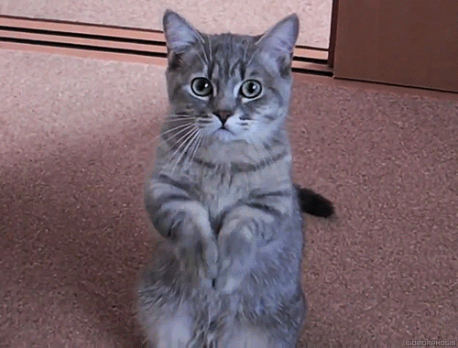
Is it a cat?

Slide 21
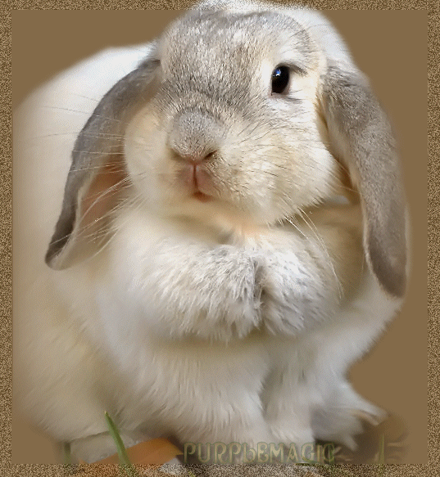
Is it a dog?

Slide 22
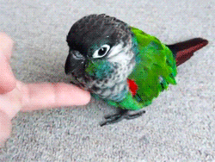
Is it a bird?

Slide 23
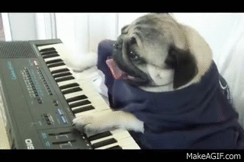
Is it a fish?

Slide 24
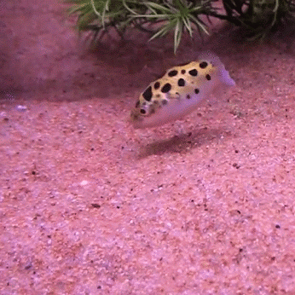
Is it a turtle?

Slide 25
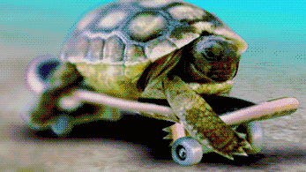
Is it a rabbit?

Slide 26
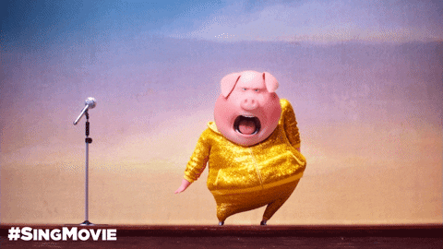
Is it a tiger?

Slide 27
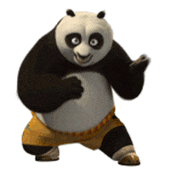
Is it an elephant?

Slide 28
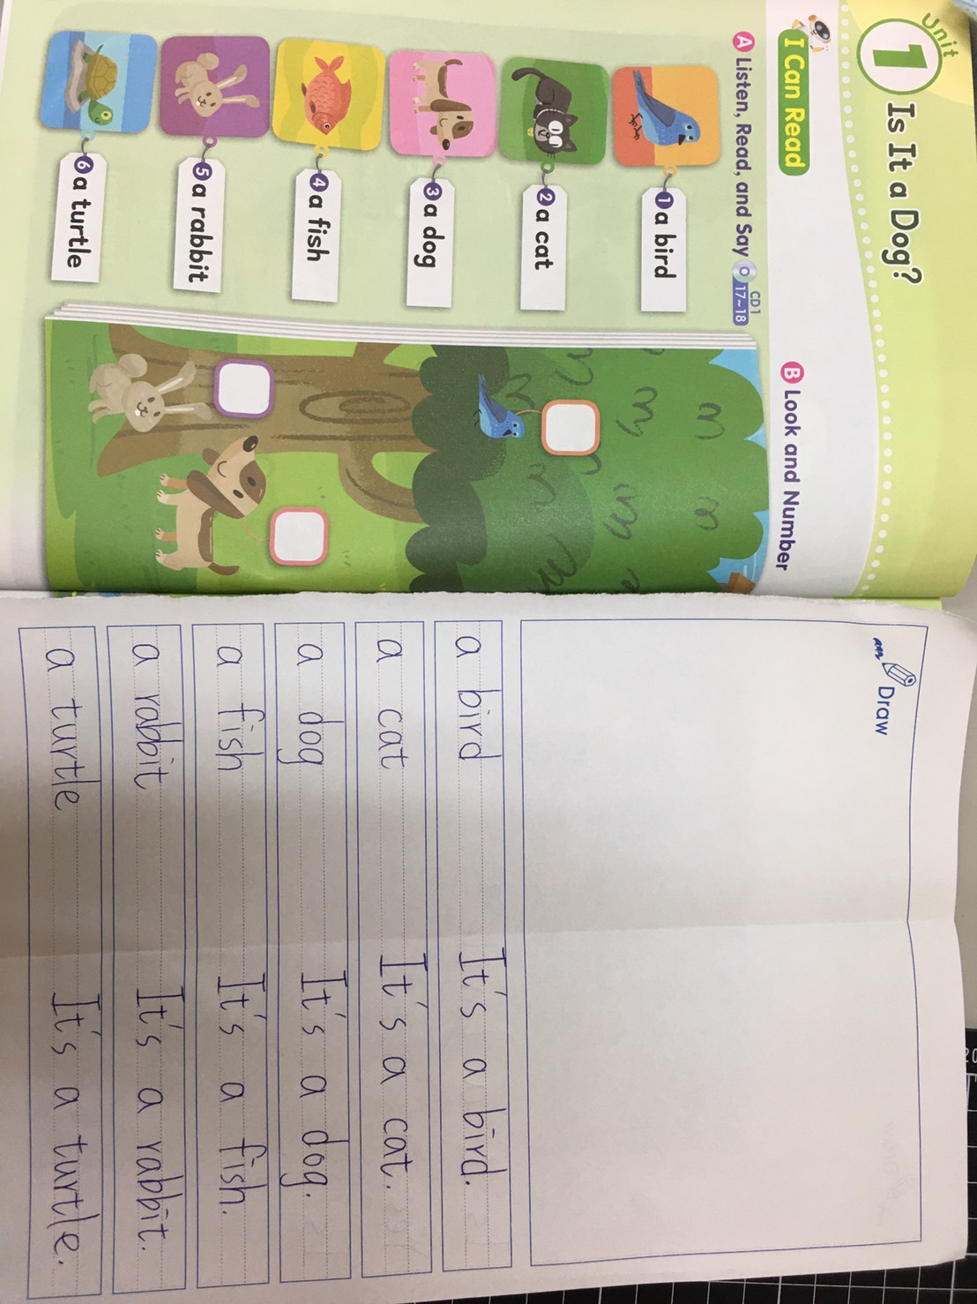

Slide 29
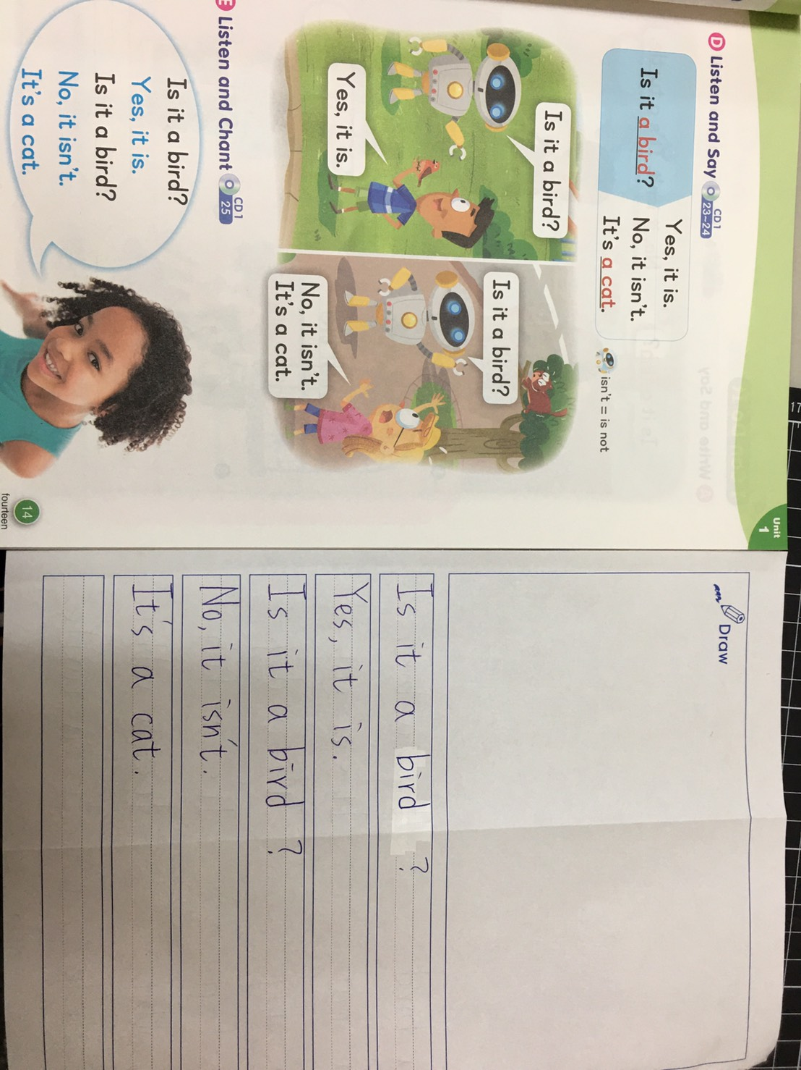

Slide 30
Homework this week
聽: CD1第23-30首。
說&讀:聽CD時跟著大聲唸。完成3遍
請家長在課本P18簽名，可換印章。
寫:英語練習簿單字+P14句型(5句)。

